Slide 1
ECON 100 Principles of Economics
Lecture 2
March 1

Slide 2
You are the manager of Company IL JK
The company provides extermination services and employs administrative workers who cannot be fired and 196 non-permanent workers who do the actual extermination work and can be fired.
The company was founded 5 years ago and is owned by three families. The work requires only a low level of skills so that each worker requires only one week of training. All of the company’s employees have been with the company for three to five years. The company pays its workers more than minimum wage. A worker’s wage, which includes overtime, amount to between 9,500 TL and 10,200 TL per month (the minimum wage is about 8500 TL). The company provides its employees with all the benefits required by law.
Until recently, the company was very profitable. As a result of the continuing recession, however, there has been a significant drop in profits though the company is still in the black. You will soon be attending a meeting of the management at which a decision will be made as to how many workers to lay off. IL JK’s Finance Department has prepared the following forecast of annual profits:

Slide 3
What would you do?
Number of workers who will continue to be employed | Expected annual profit in TL millions
0 (all the workers will be laid off) | Loss of 8
50 (146 workers will be laid off) | Profit of 1
65 (131 workers will be laid off) | Profit of 1.5
100 (96 workers will be laid off) | Profit of 2
144 (52 workers will be laid off) | Profit of 1.6
170 (26 workers will be laid off) | Profit of 1
196 (no layoffs) | Profit of 0.4
I will recommend continuing to employ ______ of the 196 workers in the company.

Slide 4
This survey question comes from a well known research article
A SCEPTIC’S* COMMENT ON THE STUDY OF ECONOMICS by Ariel Rubinstein
published in the March 2006 issue of The Economic Journal, a prestigious academic journal.
* someone who habitually doubts accepted beliefs

Slide 5

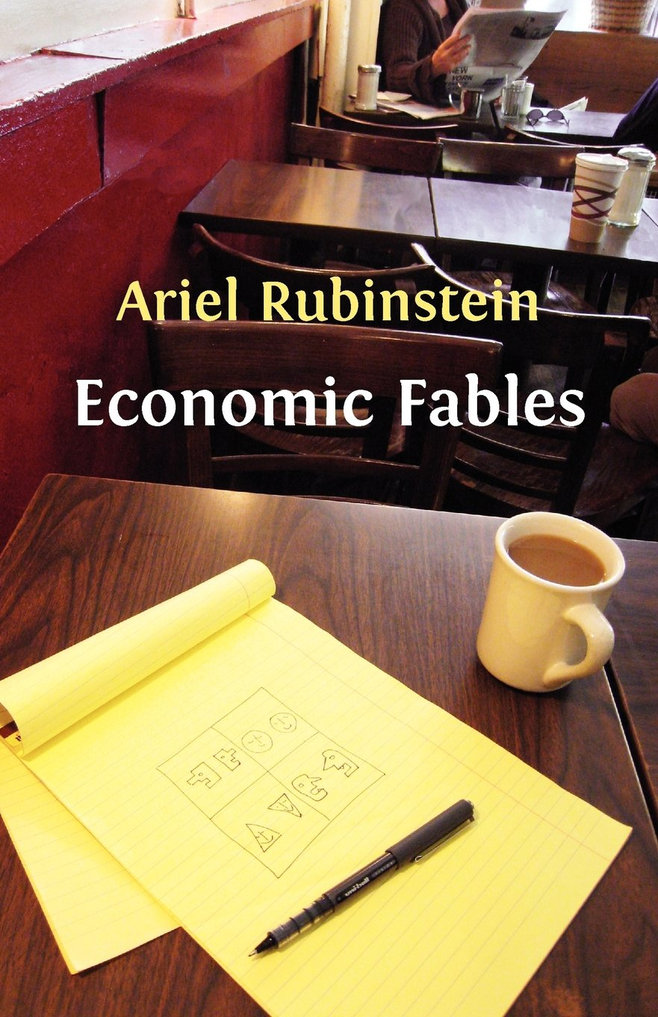
Ariel Rubinstein is one of the most important and creative economic theorists of our day. His work is in the area of game theory.
“I categorically cannot see any case where game theory could be helpful.”
http://consultingbyrpm.com/blog/2013/04/ariel-rubinstein-has-amazed-me.html

Slide 6
Ariel Rubinstein has made highly original contributions to game theory, ranging from analyses of bargaining and repeated games to models of bounded rationality.
His work – especially in bargaining, a basic economic activity – has opened up new avenues of research and new ways of thinking.

Slide 7
In his own words
After nearly forty years of engaging in this field, I have yet to find even a single application of game theory in my daily life.
In my view, game theory is a collection of fables (karınca ile ağustos böceği) and proverbs (sakla samanı gelir zamanı).

Slide 8
In his own words
Are fables useful or not? In some sense, yes.
A good fable helps us to see a situation in life from a new angle and perhaps influence our action or judgment one day.
But fables are not useful in the sense of giving you advice about what to do tomorrow, or how to reach an agreement between the West and Iran.

Slide 9
[We do game theory] because it is interesting...I believe that intellectual thinking – philosophy or logic or game theory – is very useful in the cultural sense. It’s part of the culture, it’s a part of our attempt to understand ourselves better and understand the way that we think.

Slide 10
What I’m opposing is the approach that says, in a practical situation, “OK, there are some very clever game theoreticians in the world, let’s ask them what to do.”
I have not seen, in all my life, a single example where a game theorist could give advice, based on the theory, which was more useful than that of the layman...
http://consultingbyrpm.com/blog/2013/04/ariel-rubinstein-has-amazed-me.html

Slide 11
Short summary of the article
A survey (anket) was done for two groups of undergraduate economics students and four groups of students in mathematics, law, philosophy and business administration.
The main survey question is about a conflict between profit maximisation and the welfare of the workers who would be fired to achieve it.
Significant differences were found between the choices of the groups.

Slide 12
Cont.
The results were reinforced by a survey conducted among readers of business newspapers and PhD students of MIT and Harvard.
Conclusion: the overly mathematical methods used to teach economics encourage students to show a preference for profit maximisation.

Slide 13
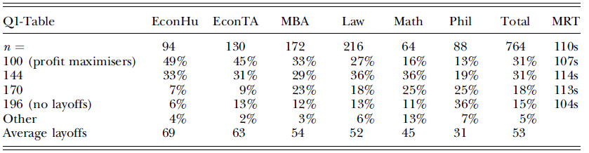
Results: Undergraduate students

Slide 14
Results: Undergraduate students

Slide 15
Results: Undergraduate students

Slide 16
Results: Undergraduate students

Slide 17
Results: Undergraduate students

Slide 18
Results: Undergraduate students

Slide 19
Results: Undergraduate students

Slide 20
What did other students do?
# of workers | Annual proﬁt | Econ HU | Econ TA | MBA | Law | Math | Phil
0 (all the workers will be laid off) | Loss of 8
50 (146 workers will be laid off) | Profit of 1
65 (131 workers will be laid off) | Profit of 1.5
100 (96 workers will be laid off) | Profit of 2 | % 49 | % 45 | % 33 | % 27 | % 16 | % 13
144 (52 workers will be laid off) | Profit of 1.6 | % 33 | % 31 | % 29 | % 36 | %36 | % 19
170 (26 workers will be laid off) | Profit of 1 | % 7 | % 9 | % 23 | % 18 | % 25 | % 25
196 (no layoffs) | Profit of 0.4 | % 6 | %13 | % 12 | % 13 | %11 | % 36

Slide 21
What did you choose? (this year)
Number of workers who will continue to be employed | Expected annual proﬁt in NIS millions | Number of students (Total: 84) | Percentage
0 (all the workers will be laid off) | Loss of 8 | 0 | %0
50 (146 workers will be laid off) | Profit of 1 | 0 | %0
65 (131 workers will be laid off) | Profit of 1.5 | 2 | % 3,33
100 (96 workers will be laid off) | Profit of 2 | 27 | % 45
144 (52 workers will be laid off) | Profit of 1.6 | 15 | % 25
170 (26 workers will be laid off) | Profit of 1 | 8 | % 13,33
196 (no layoffs) | Profit of 0.4 | 8 | % 13,33

Slide 22
What did other students do? (2012-2)
Number of workers who will continue to be employed | Expected annual proﬁt in NIS millions | Number of students (Total: 41) | Percentage
0 (all the workers will be laid off) | Loss of 8 | 0
50 (146 workers will be laid off) | Profit of 1 | 0
65 (131 workers will be laid off) | Profit of 1.5 | 1 | % 2
100 (96 workers will be laid off) | Profit of 2 | 21 | % 51
144 (52 workers will be laid off) | Profit of 1.6 | 3 | % 7
170 (26 workers will be laid off) | Profit of 1 | 8 | % 20
196 (no layoffs) | Profit of 0.4 | 8 | % 20

Slide 23
What did other students do? (2013-1)
Number of workers who will continue to be employed | Expected annual proﬁt in NIS millions | Number of students (Total: 21) | Percentage
0 (all the workers will be laid off) | Loss of 8 | 0
50 (146 workers will be laid off) | Profit of 1 | 0
65 (131 workers will be laid off) | Profit of 1.5 | 2 | % 10
100 (96 workers will be laid off) | Profit of 2 | 10 | % 48
144 (52 workers will be laid off) | Profit of 1.6 | 6 | % 28
170 (26 workers will be laid off) | Profit of 1 | 2 | % 10
196 (no layoffs) | Profit of 0.4 | 1 | % 4

Slide 24
What did other students choose? (2013)
Number of workers who will continue to be employed | Expected annual proﬁt in NIS millions | Number of students (Total: 67) | Percentage
0 (all the workers will be laid off) | Loss of 8 | 0
50 (146 workers will be laid off) | Profit of 1 | 1 | % 1
65 (131 workers will be laid off) | Profit of 1.5 | 3 | % 5
100 (96 workers will be laid off) | Profit of 2 | 43 | % 64
144 (52 workers will be laid off) | Profit of 1.6 | 15 | % 22
170 (26 workers will be laid off) | Profit of 1 | 1 | % 2
196 (no layoffs) | Profit of 0.4 | 4 | % 6

Slide 25
What did other students choose? (2014)
Number of workers who will continue to be employed | Expected annual proﬁt in NIS millions | Number of students (Total: 140) | Percentage
0 (all the workers will be laid off) | Loss of 8 | 0
50 (146 workers will be laid off) | Profit of 1 | 3 | % 2
65 (131 workers will be laid off) | Profit of 1.5 | 2 | % 1
100 (96 workers will be laid off) | Profit of 2 | 73 | % 52
144 (52 workers will be laid off) | Profit of 1.6 | 41 | % 29
170 (26 workers will be laid off) | Profit of 1 | 9 | % 6
196 (no layoffs) | Profit of 0.4 | 12 | % 8

